Slide 1
Zero-shot learning (in practice!)
Rowan Zellers
Notes:
This is going to be more of a computer visiony talk / presentation
Might be of interest to people from a general ML background but yeah I’ll leave it to you all to think about direct applications, etc.
Also want to get to tips and tricks and whatnot but I’ll be going over some backround first
Not really sure where everyone is at so feel free to interrupt
Might be somewhat discussiony
Not polished at all

Slide 2
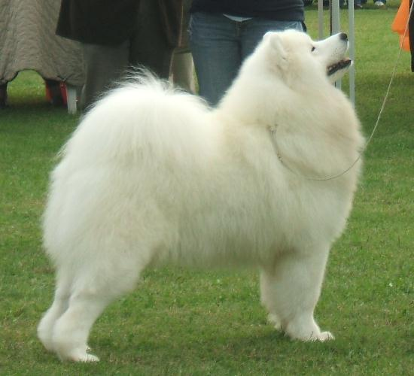
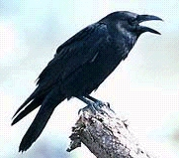

Regular
learning
dog
bird
train
test
dog

Slide 3
Definitions
Making a prediction where no labeled example of the transfer task is given
Notes:
As an example of a zero-shot learning setting, consider the problem of having
a learner read a large collection of text and then solve object recognition problems.
It may be possible to recognize a speciﬁc object class even without having seen an
image of that object, if the text describes the object well enough. For instance...

Slide 4
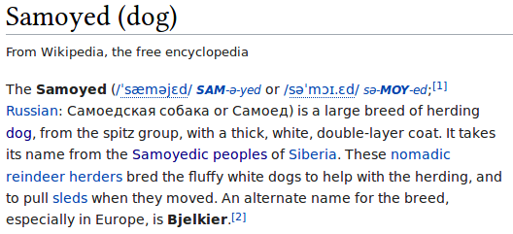
Definitions
Making a prediction where no labeled example of the transfer task is given
Notes:
As an example of a zero-shot learning setting, consider the problem of having
a learner read a large collection of text and then solve object recognition problems.
It may be possible to recognize a speciﬁc object class even without having seen an
image of that object, if the text describes the object well enough. For example,
having read that a cat has four legs and pointy ears, the learner might be able to
guess that an image is a cat, without having seen a cat before.

Slide 5
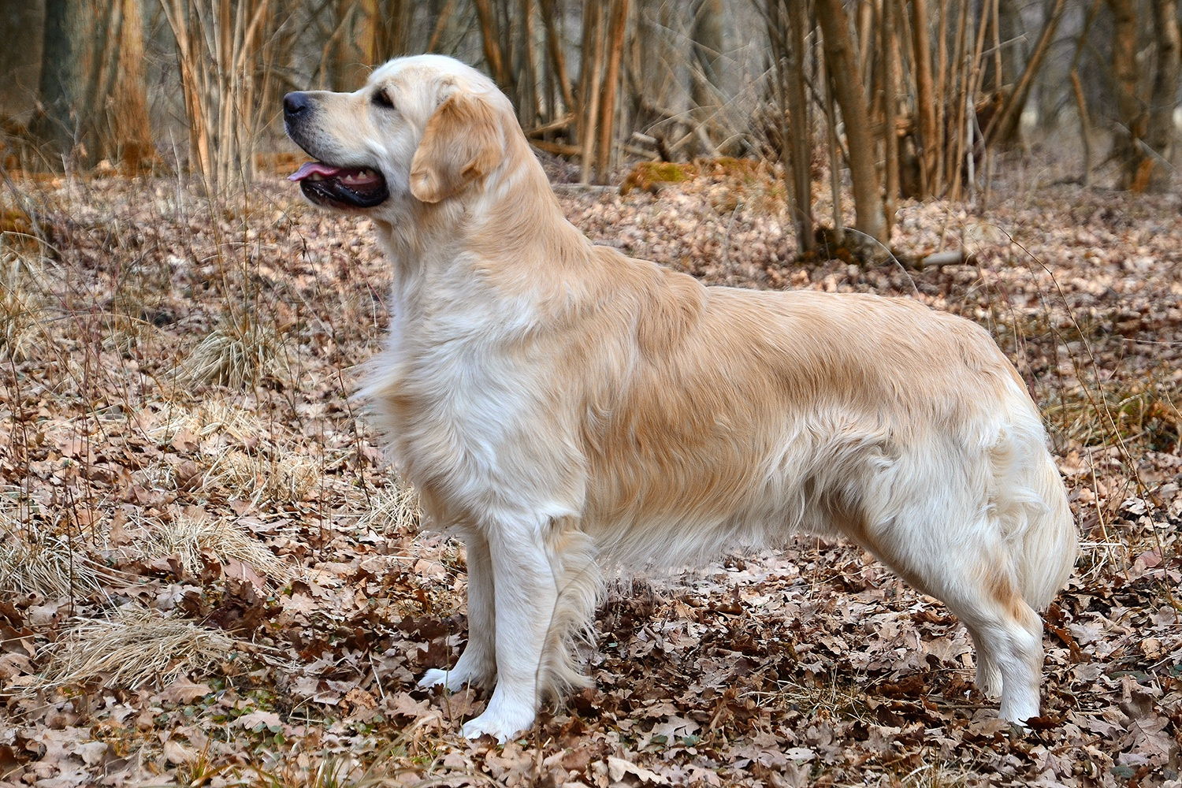
Definitions
Making a prediction where no labeled example of the transfer task is given
Notes:
As an example of a zero-shot learning setting, consider the problem of having
a learner read a large collection of text and then solve object recognition problems.
It may be possible to recognize a speciﬁc object class even without having seen an
image of that object, if the text describes the object well enough. For example,
having read that a cat has four legs and pointy ears, the learner might be able to
guess that an image is a cat, without having seen a cat before.

Slide 6
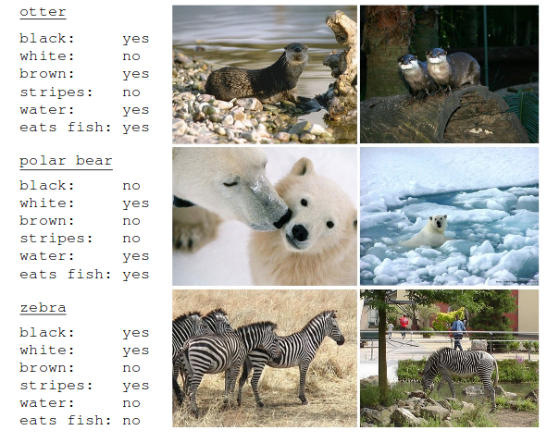
Attributes
Lampert, Christoph H., Hannes Nickisch, and Stefan Harmeling. "Learning to detect unseen object classes by between-class attribute transfer." Computer Vision and Pattern Recognition, 2009. CVPR 2009. IEEE Conference on. IEEE, 2009.

Slide 7
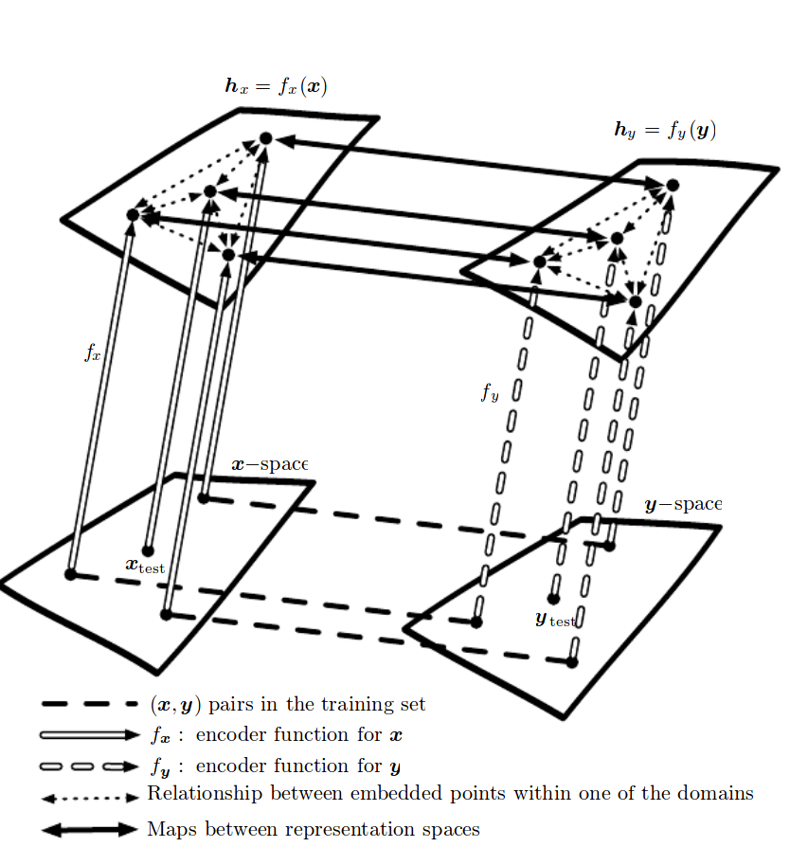
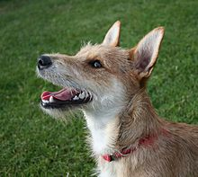
http://www.deeplearningbook.org/
{cloud, smiley}
{golden, wavy coat}
{short coat, raised ears}
Samoyed
Golden retriever
Terrier
Notes:
X space: a bunch of descriptions of dogs
Y space: a bunch of images of dogs
Training set has a mapping between them
And we have an encoder that goes to the representation space
So at test time when we see a new dog

Slide 8
{cloud, smiley}
{golden, wavy coat}
{short coat, raised ears}
Notes:
X space: a bunch of descriptions of dogs
Y space: a bunch of images of dogs
Training set has a mapping between them
And we have an encoder that goes to the representation space
So at test time when we see a new dog

Slide 9
{cloud, smiley}
{golden, wavy coat}
{short coat, raised ears}
Notes:
X space: a bunch of descriptions of dogs
Y space: a bunch of images of dogs
Training set has a mapping between them
And we have an encoder that goes to the representation space
So at test time when we see a new dog

Slide 10
{cloud, smiley}
{golden, wavy coat}
{short coat, raised ears}
{blue eyes, wolflike}
Husky!
Notes:
X space: a bunch of descriptions of dogs
Y space: a bunch of images of dogs
Training set has a mapping between them
And we have an encoder that goes to the representation space
So at test time when we see a new dog
This assumes we know the attributes for all the objects! We’ll get to this soon

Slide 11
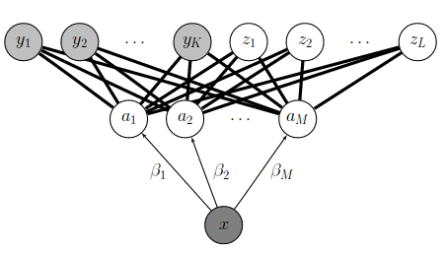
Basic model: Direct Attribute Prediction
Build a model that goes from Image->Attributes (potentially using sigmoid loss)
Lampert, Christoph H., Hannes Nickisch, and Stefan Harmeling. "Learning to detect unseen object classes by between-class attribute transfer." Computer Vision and Pattern Recognition, 2009. CVPR 2009. IEEE Conference on. IEEE, 2009.

Slide 12
Basic model: Direct Attribute Prediction
Build a model that goes from Image->Attributes (potentially using sigmoid loss)
P(floofy|x) = 0.99 P(smiley|x) = 0.9 P(smol | x) = 0.1
Lampert, Christoph H., Hannes Nickisch, and Stefan Harmeling. "Learning to detect unseen object classes by between-class attribute transfer." Computer Vision and Pattern Recognition, 2009. CVPR 2009. IEEE Conference on. IEEE, 2009.

Slide 13
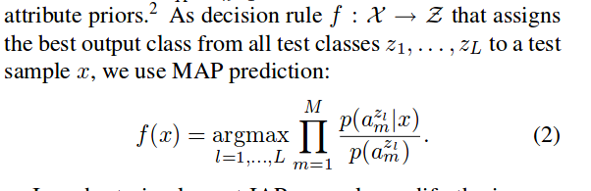
Basic model: Direct Attribute Prediction
P(floofy|x) = 0.99 P(smiley|x) = 0.9 P(smol | x) = 0.1
Lampert, Christoph H., Hannes Nickisch, and Stefan Harmeling. "Learning to detect unseen object classes by between-class attribute transfer." Computer Vision and Pattern Recognition, 2009. CVPR 2009. IEEE Conference on. IEEE, 2009.
Notes:
This works pretty well. Some issues maybe:
You might have some amount of interdependence between attributes
Training time is different from test time. So you could try to set it up in a different way...

Slide 14
Verb understanding with linguistic Attributes
Notes:
Was interested in this on the ImSITU dataset which has a lot of semantic similarity

Slide 15
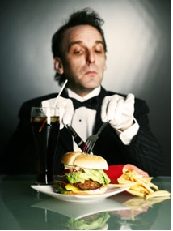
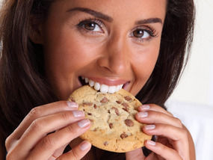
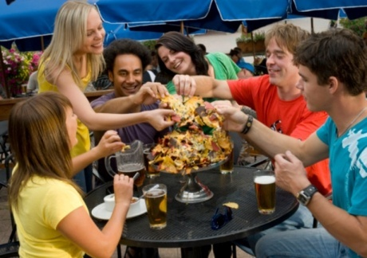
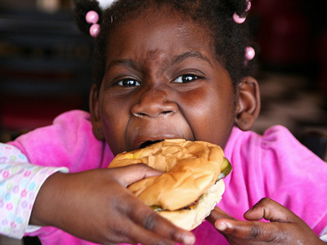
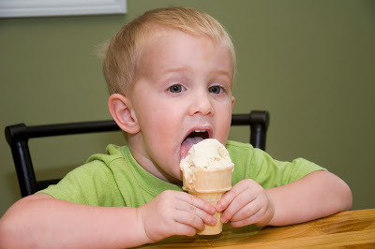
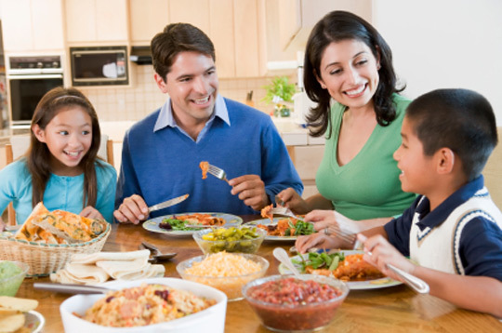
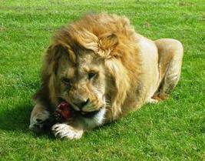
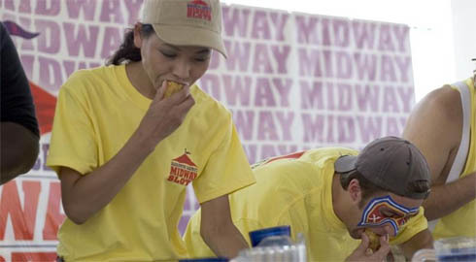
Eat
Dine

Slide 16
Solution: verb attributes
Aspectual classes
Temporal duration
Motion dynamics
Social dynamics
Transitivity
Effects on arguments
Body parts
Notes:
Not really important for this audiecne but feel free to bug me offline

Slide 17
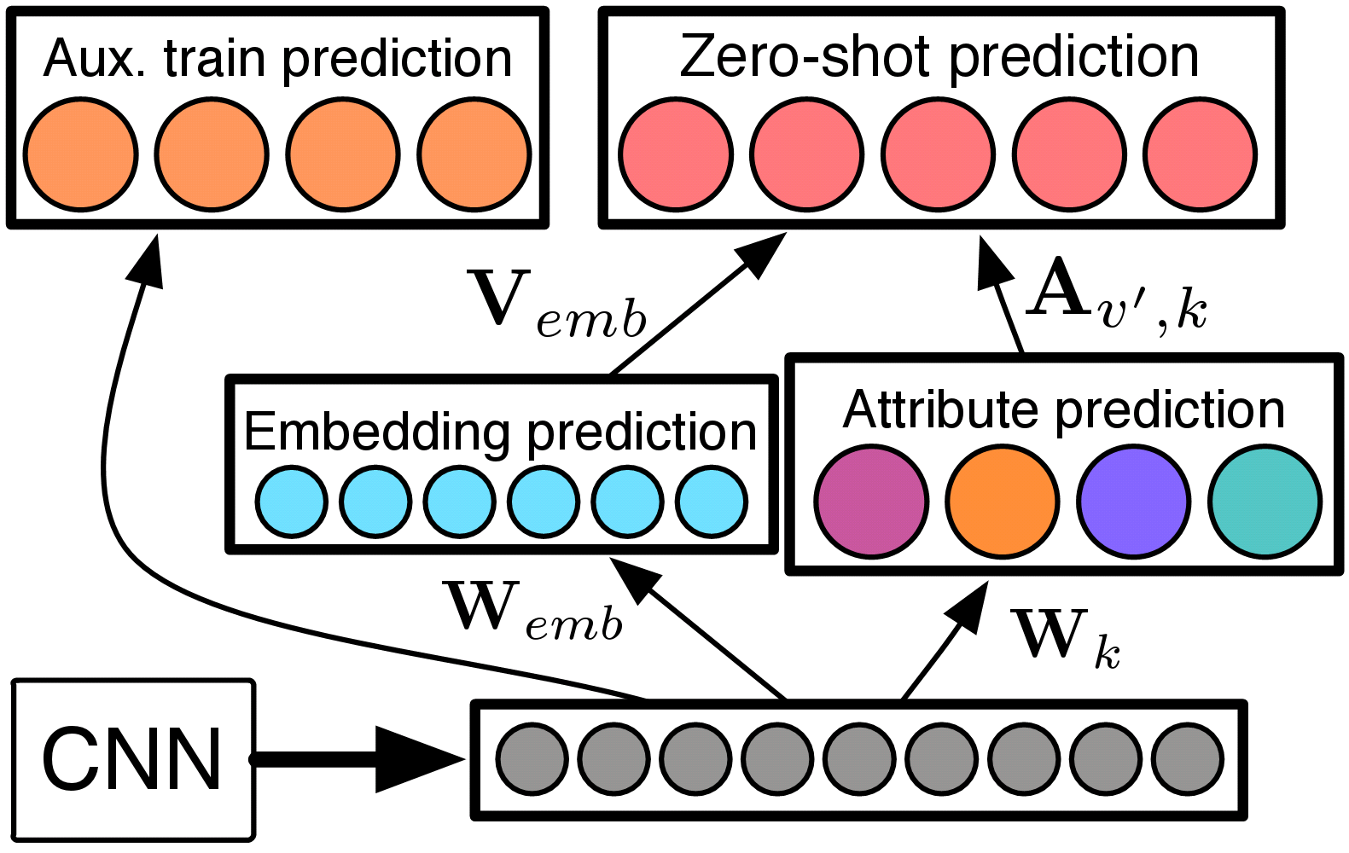

Slide 18
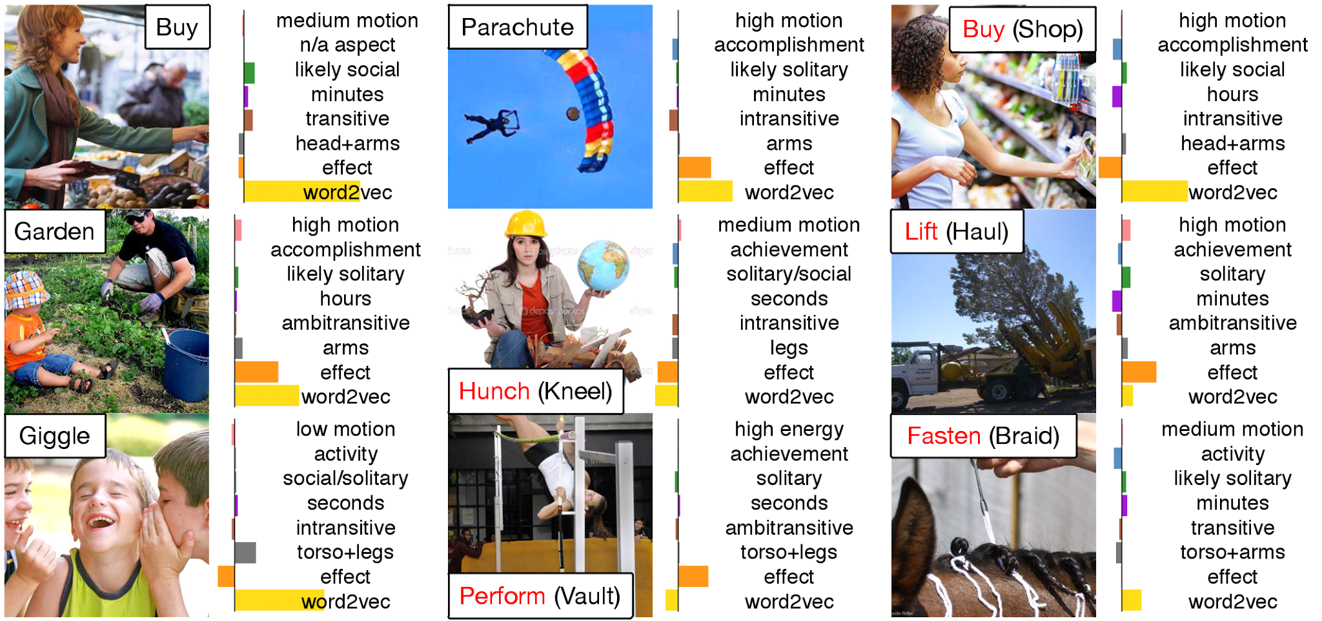

Slide 19
Learning attributes from language
Word embeddings
Definitions

Slide 20
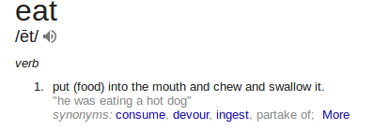
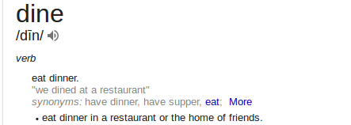

Slide 21
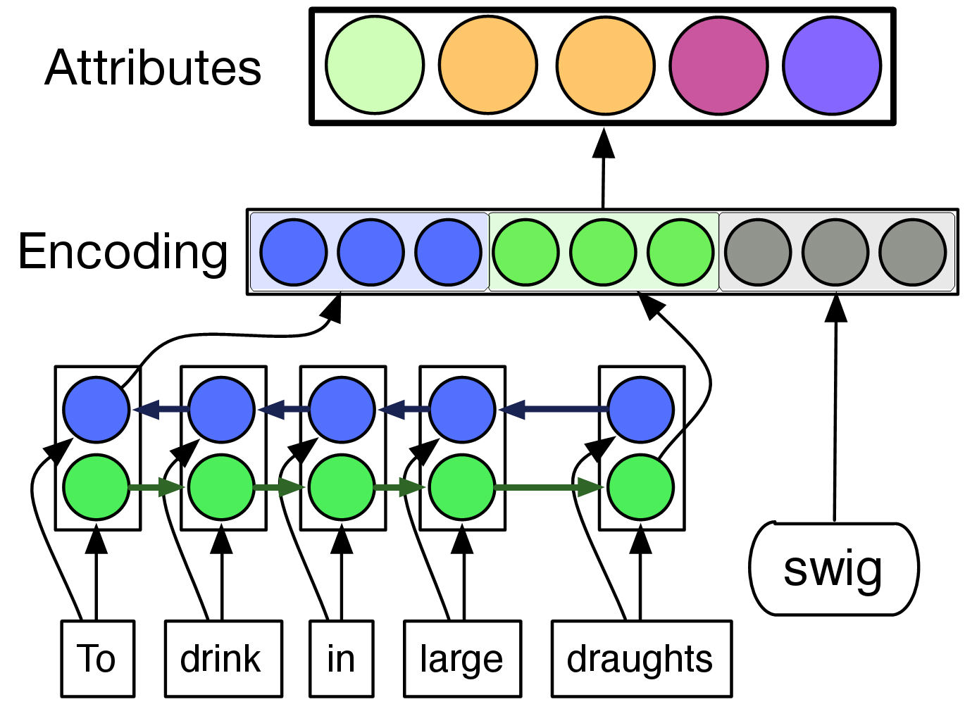

Slide 22
Summary
Attributes show promise on zero-shot activity recognition
Learning attributes from definitions allows us to describe and understand unseen verbs

Slide 23
Pitfalls
Model tends to overpredict certain verbs
Most of the gains tends to be from the embedding model
Low-data problems vs. deep learning
(misc.) Adam tends to overwrite things when epsilon is small and doing finetuning

Slide 24
Pitfalls
Hubness:
Some entries tend to have many neighbors (“hubs”)
Arguably, max-margin loss solves this
Ex. our model almost never predicts the labels for many of the ZS test items
Pollution:
The model really wants to output a label in the training set
Ex. We get much worse performance when we let the model produce the full set of labels
Marco Baroni, Angeliki Lazaridou Georgiana Dinu. "Hubness and Pollution: Delving into Cross-Space Mapping for Zero-Shot Learning." ACL 2015

Slide 25
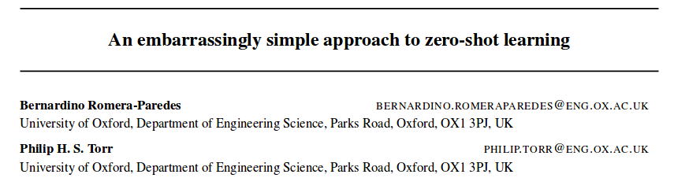
Better regularization?
ICML 2015
Constrain the activations of the model
Constrain variance of all training instances on the attribute space (such that it doesn’t overfit)

Slide 26
Questions?

Slide 27
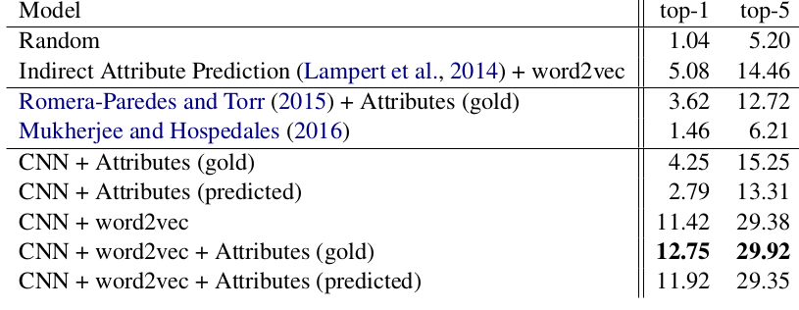

Slide 28
